Slide 1

Forecasting of Customer’s Eligibility for The Bank Loan and, Also Predict Credit Limit, Using ML Approach

Slide 2

DEMO OF THE PROTOTYPE SYSTEM
D N Pathirathna
Final Year Undergraduate Student

Slide 3
CONTENT
What is the Problem ?
Found Solution
Possible Improvements for the current prototype

Slide 4
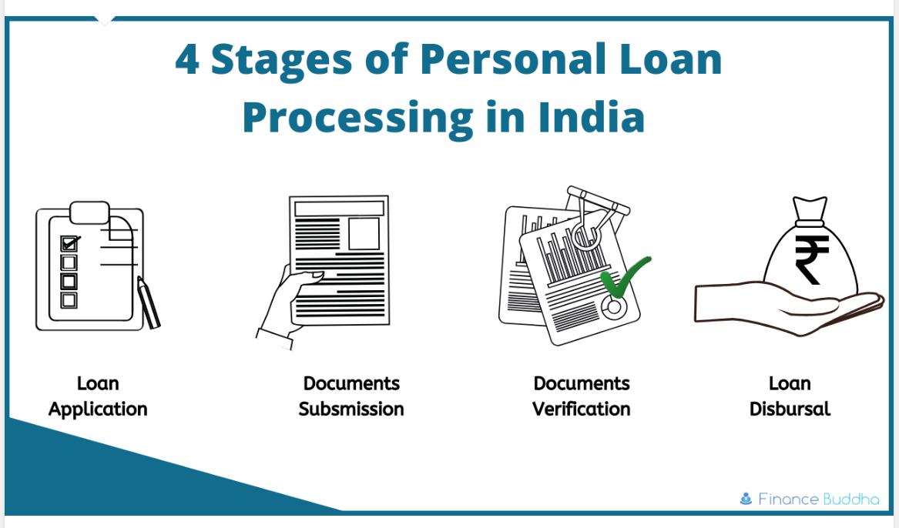
WHAT IS THE PROBLEM ?

Slide 5
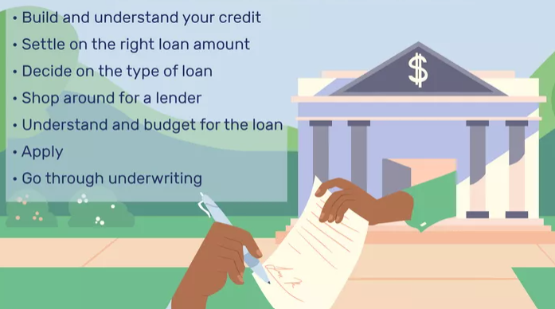
HOW TO GET A BANK LOAN ?

Slide 6
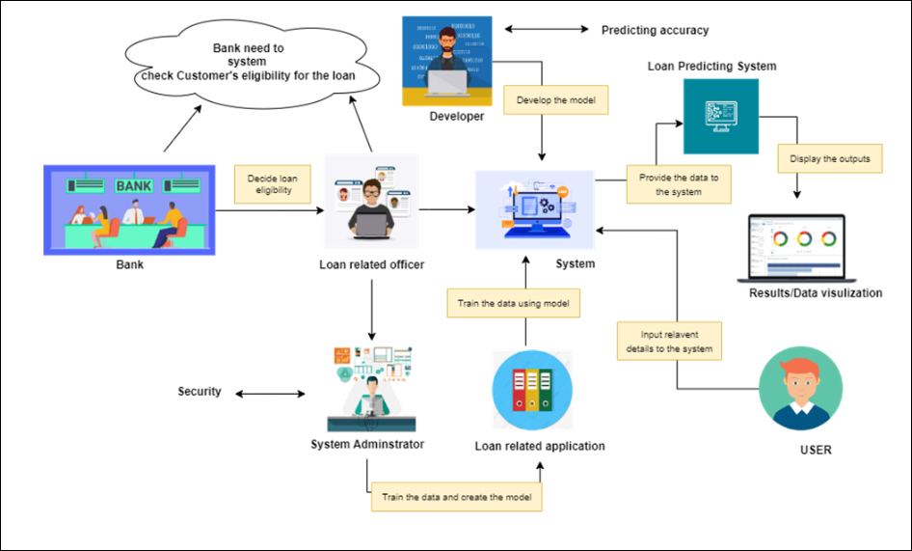
SOLUTION

Slide 7

POSSIBLE IMPROVEMENTS FOR THE CURRENT PROTOTYPE

Slide 8
Feature Engineering: Improving the features used to train the model, by considering additional relevant information like the borrower's job history, credit history, and debt-to-income ratio.
Model Selection: Evaluating multiple algorithms to determine the best model for the given problem. For instance, using hybrid ML model for the prediction.
Hyper parameter Tuning: Fine-tuning the parameters of the selected model to improve its performance, using techniques such as grid search or random search.
Over fitting Prevention: Regularizing the model to avoid over fitting to the training data, by using techniques like dropout or L1/L2 regularization.
Data Imbalance: Dealing with imbalanced classes in the target variable by oversampling the minority class, under-sampling the majority class, or using a combination of both.

Slide 9
THE END & THANK YOU

